Slide 1

Conducting Research on the Internet
Lecture 4

Slide 2
Learning Topics
Internet as tool to perform research
Why to evaluate a web source
Research and the Internet
Types of Web pages
Web search tools
Researching on the Internet

Slide 3

Internet to research
Research allows us to move from ignorance to knowledge
There is a wealth of information at our fingertips
We only need to know how to access it
The Internet can be a great tool for research but finding quality web materials and using them to your advantage in your writing can be challenging.

Slide 4

Why do we need to evaluate web sources?
All sources are not created equal. People write for many reasons – to inform, to entertain, to persuade, to describe, to mislead, to satirize – and the quality of information depends on this purpose.
In an academic assignment, it is important to use evidence that is reliable, accurate, objective, and up-to-date.
Large volumes of information.
Does not contain all information.
Virtually any person can publish almost anything on the Internet.
Unlike most print sources, web sources do not have to be professionally accepted and edited to be published.

Slide 5
Why do we need to evaluate web sources?
Personal Experience: Overgeneralisation, Hearsay
Printed sources: books and articles
Online sources
Notes:
Many first-time students rely only on their own personal experience when writing an assignment. While it is important to provide your own perspective and interpretations, there are some risks in depending solely on experience to further your argument.
Outside sources, especially academic sources, consider multiple sources of information together to build a bigger picture of the topic. They rely on evidence, logic, and research to establish their points. For these reasons, outside sources are usually considered more valuable for the purposes of assignment writing.
It is still possible (and, often, important) to present your own position on a topic, but that position should be supported by evidence from other sources wherever possible.
Note: the amount of personal experience that can be used in an assignment varies from discipline to discipline, and assignment to assignment. Reflective writing for example, emphasises personal experience.
The quality of a printed source can vary widely. A popular magazine article does not have the same burden of evidence and thoroughness as an article published in an academic journal. There are a number of clues that can be used to determine the value of a printed source.
Sources that check their facts are better. Look for footnotes, a list of references, or other evidence that it has been well researched.
Sources with systematic quality controls are better. Look for an editor, editorial board, or other evidence of peer review.
Up-to-date sources are better. What could have changed about the topic since its publication?
Consistency with existing knowledge is important. If a source contradicts what you already know or have already read, examine its evidence carefully.

Slide 6

Internet Domain
A domain name is a unique name that identifies a website.
For example, the domain name of the BBC is ”bbc.co.uk"
Each website has a domain name that serves as an address, which is used to access the website.

Slide 7
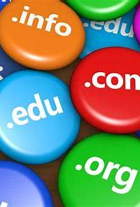
Types of web pages
Informative pages
Personal web pages
Political/interest group pages
Marketing-oriented or “infomercial” pages (advertisement pages)
Entertainment pages
Differentiate between these types of websites:
.com, .edu, .gov, .org, .co.uk, ac.uk etc

Slide 8
Types of web pages
.com, co.uk
This is a commercial site. The information provided by commercial interests is usually trying to promote something.
.edu, ac.uk
refers to Educational institution.
If a resource is from a department of research, it can generally be taken as credible.
However, students' personal Web sites are not.
.gov
refers to Government.
If you come across a site with this domain, then you're viewing the USA or the UK government site.
All branches of the United States federal government use this domain. Information such as Census (population) statistics etc.
The information is considered to be from a credible source.

Slide 9
Types of web pages
.org
refers to Traditionally a non-profit organization.
Generally, the information in these types of sites is credible and unbiased.
You probably want to give this domain a closer look these days.
.mil
refers to Military.
This domain suffix is used by the various branches of the Armed Forces of the United States.
.net
refers to Network.
You might find any kind of site under this domain suffix.
It acts as a catch-all for sites that don't fit into any of the preceding domain suffixes.
Information from these sites should be given careful scrutiny.

Slide 10
Web Search Tools
Search Engines – list results based on entered keywords. Examples: google, bing, msn etc
Web Directories – offer categories for users to choose from
Metasearch Engines – combine results from multiple search engines

Slide 11

Search Engines
Search engines help you identify information online. With the help of complex algorithms, they provide you with a list of different sources from across the web, matching the key words that you have entered.
Google Scholar: Free to use, access to millions of academic journal articles online
Google Books: Free service, access to millions of books online
Bing Images: Search for images
Europeana.eu: Collections to discover thousands of cultural artworks, books, videos in Europe
Worldcat.org: Access to search for information in more than 10,000 libraries worldwide
Academia.edu, Base-search.net, Refseek.com: Academic Search Engines.
Speacialist search engines, such as EBSCO, PROQUEST must have subscriptions
Google, Bing, and Yahoo access the greatest percentage of the World Wide Web (Ebizmba.com, 2019)
https://www.youtube.com/watch?v=R0DQfwc72PM
Watch a video on the above link

Slide 12
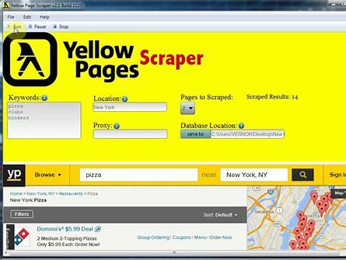
Search directories
Search engines constantly surf the internet using programs ‘robot’ or ‘spider’24 hours a day
They archive, analyse and catalogue all od the pages encountered.
Then the pages are added to the database or ‘INDEX’
Search Directories perform the same function as search engines but they do not use computers to rank pages, they use people.. Similar to Yellow pages
Examples:
Yahoo is the best known search directory, although many people confuse with a search engine.
Botw.org, dmoz.org

Slide 13
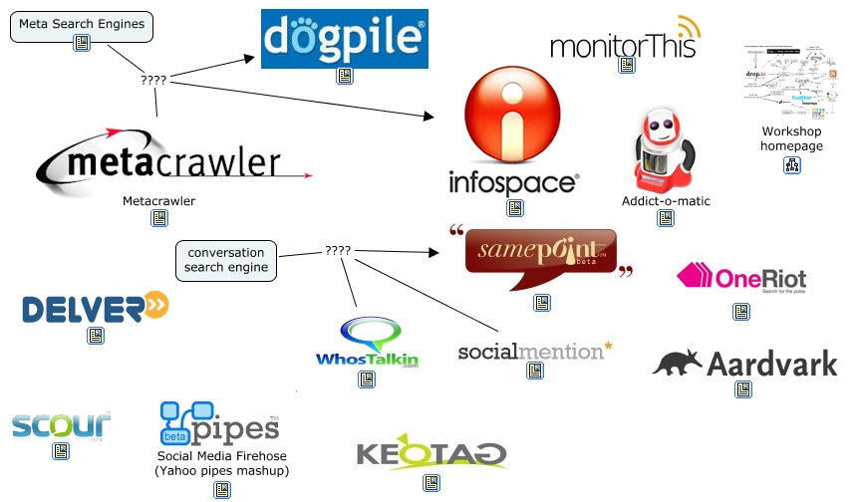
Meta search engines
Meta-search engine is a web-based service that aggregates data from a number of search engines.
A meta search engine doesn't have a database of indexed pages of its own.
Instead it "sends a user's query to multiple search engines and blends the top results from each into one overall list.”
Examples:
DogPile.com
Yippy.com (used to be Clusty)
IxQuick.com
iBoogie.tv
Kartoo.com
SurfWax.com
Mamma.com

Slide 14
Researching the Internet
Affiliation
Audience Level
Currency
Use web search tools to your advantage
Authority
Content Reliability/Accuracy
Source of the research

Slide 15

Researching the Internet - authority
Credibility may be compromised by purposeful misinformation or by unintentional neglect.
Who is the author?
Is the author’s name(s) given?
Credentials may be missing even if the author’s name is provided.
Are their qualifications specified?
Is there a link to information about them and their position?
Is there a way to contact them?
Have you heard of them elsewhere?
Has the author written elsewhere on this topic?
A list of sources or works cited page?

Slide 16

Researching the Internet - Affiliation
Who is the sponsor of the web site?
Is the author affiliated with a reputable institution or organization?
Does the information reflect the views of the organization, or only of the author?
Does the source have a political or business agenda?

Slide 17

Researching the Internet - Audience
What audience is the Web site designed for?
Students
Academics
Research funding bodies
Press and Media
Parents and Guardians
Kids
Young adults
Pensioners
etc

Slide 18

Researching the Internet - currency
Is the Web site current?
Is the site dated?
Is the date of the most recent update given ?
Are all the links up-to-date and working?

Slide 19

Researching the Internet - Reliability/accuracy
Is the material on the Web site reliable and accurate?
Is the information factual, not opinion?
Can you verify the information in print sources?
Is the source of the information clearly stated?
Whether original research material or secondary material borrowed from elsewhere?

Slide 20

Researching the Internet - validity
Does the material as presented have substance and depth?
Where arguments are given, are they based on strong evidence and good logic?
Is the author’s point of view impartial and objective?
Is the author’s language free of emotion and bias?
Is the site free of errors in spelling or grammar and other signs of carelessness in its presentation of the material?

Slide 21

Researching the Internet - summary
Authority – Are the people responsible for the web-site’s content regarded as experts or authorities on that topic?
Accuracy – Does the web-site contain misinformation?
Objectivity – Does the web-site present an extreme one-sided or balanced perspective?
Currency – Is the information on the web-site up-to-date?
Coverage – How much information does the web-site provide?
No criteria by itself is indicative of a web-site’s value to your needs. You should look at the criteria as a whole.

Slide 22
References
Ebizmba.com. (2019). Top 15 Most Popular Search Engines | January 2019. [online] Available at: http://www.ebizmba.com/articles/search-engines [Accessed 14 Apr. 2019].

